Slide 2
Introduction
Data Trends
Regulations
Cost
K-Anonymity
L-Diversity
Contribution
Analysis
Conclusion

Slide 3
Big Data Trends
Data grows exponentially
Eliminate $200 Billion in waste
Smart Cities
.5% of data is analyzed
Data Breach Severity
Number of Rows
Impact on an individual’s life
Notes:
http://www.businessinsider.com/mind-blowing-growth-and-power-of-big-data-2015-6
http://www.businessinsider.com/big-data-tackles-energy-waste-from-big-buildings-2015-5
Big Data can analyze information at a much faster rate
For example, Assessing the energy consumption of a building – The amount of time needed to assess one building can now be assessed in the thousands due to enhancements in processing Big Data
NYU’s Center for Urban Science and Progress is partnered with NYC’s Hudson Yards neighborhood in developing our nation’s first quantified community.
Tracking air quality, pedestrian traffic, energy production and consumption
.5% of data is analyzed, this number is expected to shrink
Data Breach Severity is often measured in rows, we are approaching it from the impact on an individual’s life

Slide 4
Regulations
European Union Agency for Network and Information Security
Handles information and network security for the EU
Guidelines
Prepare, Detect, Notify and Respond
Emphasis on measuring impact and severity

Slide 5
Cost
Impact emphasis can be based on sector
Public Organization
5% decrease in stock price due to confidential data breach
Data Breaches with no confidential data had zero impact
Loss of 2.1% in market value within 2 days of disclosure

Slide 6
K-Anonymity
Sweeney et al.
Quasi-identifiers must occur k number of times
Q-block
Each q-block will have k number of tuples with similar quasi-identifiers
87% of individuals could be identified with their 5-digit zip code, gender and date of birth

Slide 7
K-Anonymity
Protect against inference and linkage attacks
Unintended disclosures
Individual queries may not post a risk
Linked together may disclose sensitive information

Slide 8
Traditional Techniques
Generalize data by adding noise
Damage the integrity
Statistical Data
Lower classified information can leak higher classified information
Protect with a strong database design
Problem: Data replication
Multi-level databases
Suppress Data
Loses Utility

Slide 9
K-Anonymity
Each sequence of values appears k times
Cannot link fewer than k individuals
Protects against matching to known external sources

Slide 10
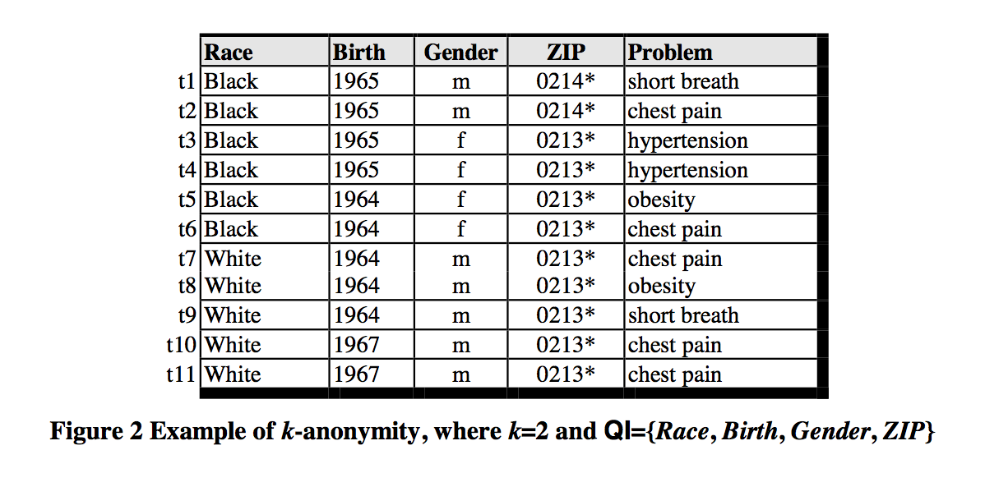
K-Anonymity

Slide 11
K-Anonymity
Attacks Against K-Anonymity
Unsorted matching
Row’s index matches private table’s positions
Complementary release
Two generalized tables form a linked table
Temporal attack
New generalized table based on the same data does not consider the original released table

Slide 12
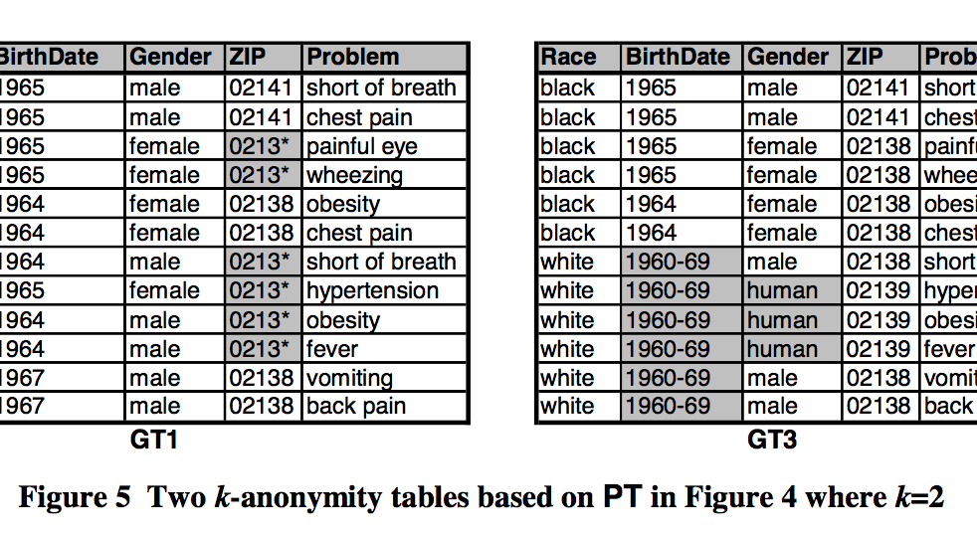
Example of a Temporal Attack
Notes:
Data should never be more specific than the original released data

Slide 13
L-Diversity

Slide 14
L-Diversity
Presents two attacks on k-anonymity
Homogeneity Attack
Background Information
Proposes two techniques
Bayes Optimal
L-Diversity

